Slide 1

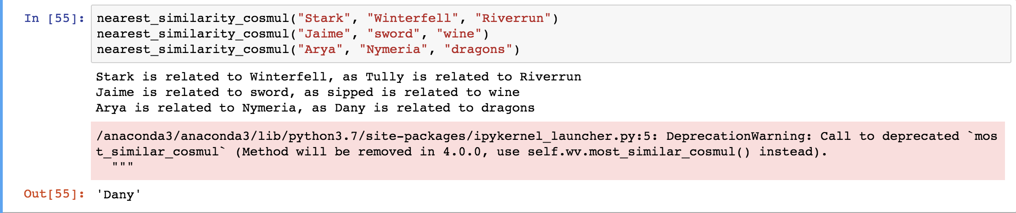


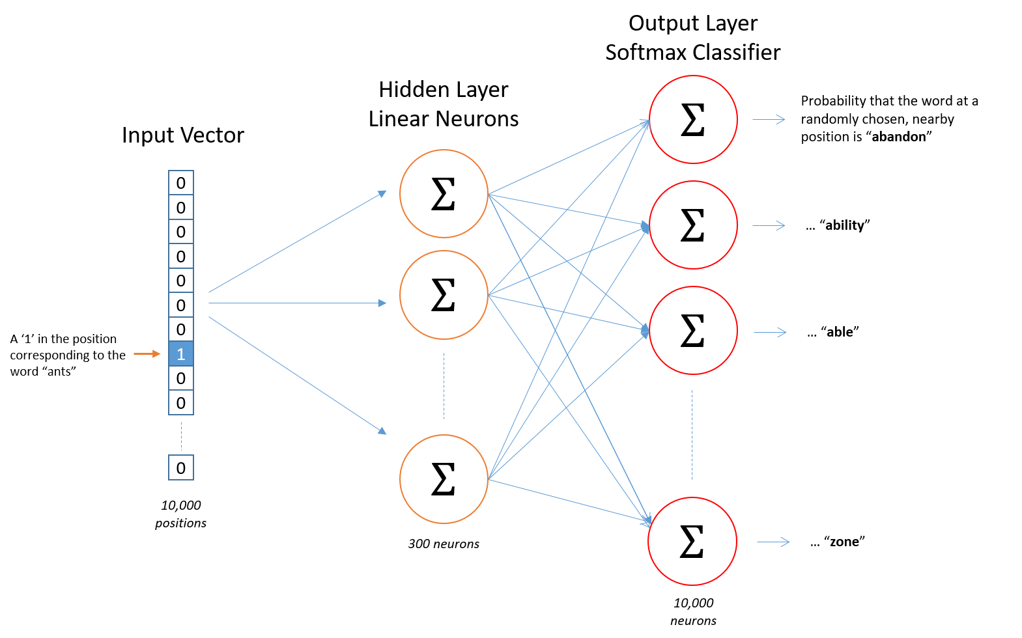
Word2vec’s Skip-Gram Model Implemented on Game of Thrones Dataset
Pooja Sen
Advisor: Dr. Daniel Leonardo Pimentel Alarcon
Abstract
Methods and Materials
In the era of Data Driven World, the amount of data is just increasing. In fact, the amount of electronic data that exists today is massive and is growing at a rapid rate – more than 2.7 zettabytes (that’s a 1 with 21 zeroes after it) of data exist today. This is projected to grow to 67 times that number in less than two decades. Humans can deal with text format quite intuitively but provided we have millions of documents being generated in a single day, we cannot have humans performing tasks like clustering, classification, etc. It is neither scalable nor effective. Computers cannot understand or process text data. The solution to this problem is to create a representation for words that capture their meanings, semantic relationships and the different types of contexts they are used in. These are implemented by using Word Embedding or numerical representations of texts so that computers may handle them.
In my project I have used a very exciting dataset which is the Game of Thrones Dataset. The five books of Game of thrones actually make my dataset. I have implemented the Word2vec’s Skip Gram Model(SGM) on the dataset to visualize some interesting findings. Reproducibility is a serious concern in the science community. Hence, I made a tutorial that ensures that the results are reproducible.
Key idea: Predict surrounding words of every word.
Represent each word with a low-dimensional vector(One hot encoding). Feed it into the SGM and predict he surrounding words of the given word. SGM is a shallow neural network model where there are three layers namely; 1 input, 1 hidden and 1 output layer. The input to the neural network is the target word, while the outputs are the words surrounding the target words. We convert the input word into One-hot encoding and feed it to the network.
In my research, the latent dimension is d=300, so for visualization, I have used 2 very popular dimension reduction technique; PCA and TSNE. I have compared the result (shown in below table1) of PCA(300d to 2d ), TSNE(300d to 2d) and PCA(300d to 50d) +TSNE(50d to 2d). There is no significant difference in the findings.
I have used Google’s pretrained Word2Vec model from the popular NLP python package called Gensim. It is Robust, efficient and hassle-free piece of software. It is a free Python library designed to automatically extract semantic topics from documents, as efficiently (computer-wise) and painlessly (human-wise) as possible. I have also made a tutorial for beginners to replicate the code for SGM on GOT dataset.
Reproducibility is a serious concern in the science community. It is important because it is the only way that an investigator can guarantee about a study, it ensures that the results are correct and transparent and gives us confidence in understanding exactly what was done. Continuity is also an advantage of this tutorial.
Chart 1. Similarities Results bar diagram
Introduction
There are the humongous amount of text data available. Raw data is often “unclean” and unstructured. Natural Language Processing (NLP) practitioners are familiar with this issue as all of their data is textual. And because most of Machine Learning algorithms can’t accept raw strings as inputs, word embedding methods are used to transform the data before feeding it to a learning algorithm.
Goal: To develop SGM to predict neighboring words in sentences in the GOT dataset and to find similarity between words in the GOT dictionary and do a 2D mapping of the words for visualization.
We need effective representation of Words, Sentences, and Text. We will use a one-hot-encoding representation to transform the text in our dataset to binary feature vectors that can be used in a SGM
Results
3 scenarios were compared;
PCA - 300 dimension to 2 dimension.
TSNE - 300 dimension to 2 dimension.
PCA + TSNE - 300 dimension to 50 dimension using PCA and then to 2 dimension using TSNE.
There is no significant difference when used on the Got dataset in all these approaches.
 | TSNE | PCA | PCA + TSNE
Pepper vs clove | 0.88 | 0.89 | 0.86
Winterfell vs North | 0.66 | 0.69 | 0.67
Stark vs Eddard | 0.73 | 0.75 | 0.75
Aerys vs Mad | 0.77 | 0.76 | 0.77
Conclusions
Word2Vec’s SGM is faster and can easily incorporate a new sentence/ document or add a word to the vocabulary. Future work is to use SGM on different other biological dataset and analyze them.
The tutorial is available on https://github.com/PoojaData/Word2Vec-Game-of-thrones
Table 1. Similarities Results
Contact
References
Pooja Sen
Georgia State University
Email: psen1@student.gsu.edu
Website:
Phone: 9794927448
1.Stanford CS224d: Deep Learning for NLP http://cs224d.stanford.edu/index.html
2. Siraj Raval https://github.com/llSourcell
3.Deep Learning by Andrew NG https://www.coursera.org/specializations/deep-learning
5. https://papers.nips.cc/paper/5021-distributed-representations-of-words-and-phrases-and-their-compositionality.pdf

